Slide 1
Angular Material
Material Design
Lecture 1
By James(Jin) Wang
10/06/2022

Slide 2
Course Overview
Material Design
Setup Development Environment
Build an Application
Summarize

Slide 3
Outline
Material Design Goals
Key Principles

Slide 4
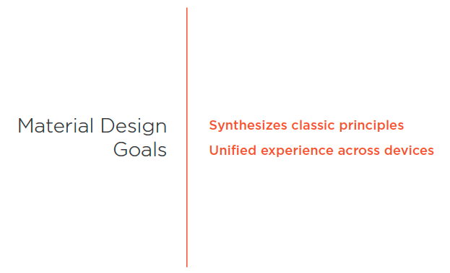
Material Design Goals
  Material Design Goals

Slide 5
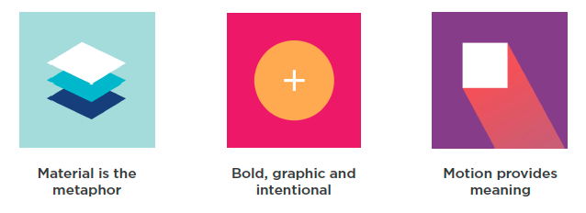
Key Principles
  Principles

Slide 6
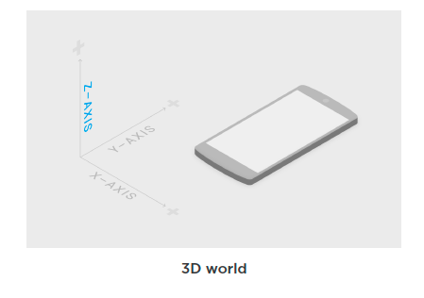
Key Principles
  Environment

Slide 7

Key Principles
  Material Casts Shadows

Slide 8
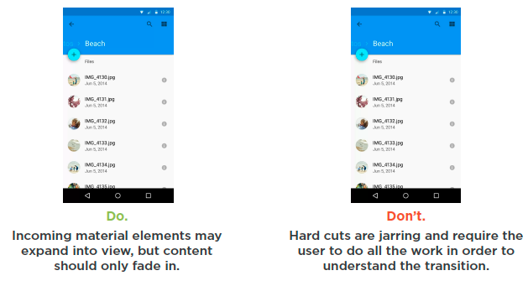
Key Principles
  Meaningful Transitions

Slide 9
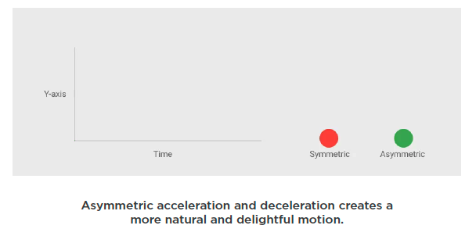
Key Principles
  Natural Acceleration and Deceleration

Slide 10
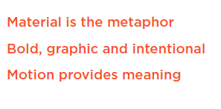
Summary

Slide 11
Assignment

Slide 12
Self Study
  Styling Application with Angular Material
  https://app.pluralsight.com/library/courses/angular-material

